Slide 1
Program Evaluation: Overview
Eugene Lengerich, VMD, MS
Jim McKenzie, PhD, MPH, MCHES
Professors
Department of Public Health Sciences
College of Medicine
Penn State University
Michelle Revels, MA
Senior Manager
ICF International

Slide 2
Session Agenda
Program Evaluation Overview
Program Evaluation vs. Research Evaluation
Defining the Question and Indicators
Connecting Logic Models and SMART objectives
Incorporating Theory
Evaluation Methods
Selecting the right method
Focus Groups
Data Analysis
Resources

Slide 3
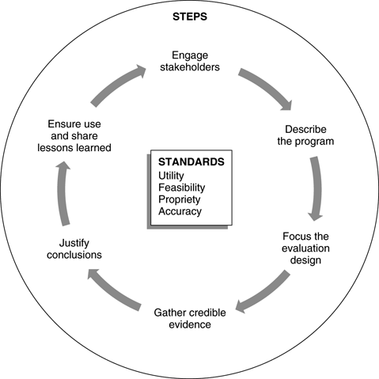
Framework for Program Evaluation*
*CDC, 1999

Slide 4
Differences Between Program & Research Evaluation
Program evaluation – can be focused on program quality, program effectiveness, or both; internal validity
Research evaluation – “attempts to produce evidence to support or reject a research hypothesis and to demonstrate a cause-effect relationship between the intervention and the impact or outcome” (Windsor et al., 1994, p. 27); external validity (generalizable knowledge)

Slide 5
Description of the Program - 1
Description is comprised of several key parts:
Title of the program
Stakeholders
Mission of the program
Goals of the program
Objectives of the program
Critical components – inputs, outputs, & outcomes (logic model)
Priority population

Slide 6
Relationship of Mission, Goals & Objectives
Mission
Statement
Goals
Objectives

Slide 7
Criteria for Developing Objectives
Elements | Part of SMART
Priority Population (Who?) | Specific
Conditions (When?) | Time-phased
Outcome (What?) | Specific & Measurable (& observable)
Criteria (How much?) | Achievable & Realistic

Slide 8
Levels of Program Objectives
Type | Program Outcome | Type of Evaluation
Process | • Activities presented & tasks completed | Process (form of formative
Impact – Learning – Behavioral – Environmental | • Change in awareness, knowledge, attitudes, skills • Change in behavior • Change in environment (physical, social, political, psychological, economic, or service) | Impact (form of summative)
Outcome | • Change in QoL, health status, risk factors, or social benefits | Outcome (form of summative)

Slide 9
What is a Logic Model?
A logic model– “is a simplified picture of a program, initiative, or intervention” (U. of WI, 2002, p. 2); comprised of a series of if – then statements (WKKF, 2004)
The purpose– “is to provide stakeholders with a road map describing the sequence of related events connecting the need for the planned program with the program’s desired results” (WKKF, 2004).
Helps to see what goes into the development of a program; links resources with activities & results

Slide 10
Logic Model & Types of Evaluation
Inputs
Outputs
Outcomes
What is invested?
What is done?
What results?
Process evaluation
Impact & Outcome evaluation

Slide 11
Defining the Question/Issue for Program Evaluation
What questions do you want your evaluation to answer?
Consider…
The purpose of the evaluation
What exactly do you want answers to?
Why do you need the answers to the questions?
What questions do the stakeholders want answered?

Slide 12
Purpose of Program Evaluation - 1
There are two major purposes of program evaluation–
Assessing quality for program improvement &/or (accomplished via process/formative evaluation)
Determining program effectiveness (accomplished via summative evaluation)
Process (sometimes referred to as formative) evaluation – “measurements obtained during the implementation of program activities to control, assure, or improve the quality of performance or delivery. Together with preprogram studies makes up formative evaluation” (Green & Lewis, 1986, p. 364)
Summative (includes impact [immediate results] & outcome [long term results]) evaluation – “any combination of measurements obtained and judgments that permit conclusions to be drawn about impact, outcome, or benefits of a program or method” (Green & Lewis, 1986, p. 366)

Slide 13
Comparison of Evaluation Terms*
Planning
Start of
Implementation
End of
Implementation
Formative
Summative
Process
Impact
Outcome
*McKenzie et al., 2009, p. 340

Slide 14
Purpose of Program Evaluation - 2
Process evaluation is based on process objectives &
Focuses on the quality of program content & program implementation; it begins at the inception of the program & runs through implementation
Quantifies what was done; when, where, & how it was done; who was reached; & how they participated
Informs stakeholders of important findings that could improve a program or its delivery
Summative evaluation is based on impact & outcome objectives &
Focuses on program effectiveness; did the intervention make a difference
It can include cost (economic) analysis
Cost-identification (feasibility) analysis - total costs
Cost-benefit analysis (CBA) - $ benefit vs. $ invested
Cost-effectiveness analysis (CEA) - cost to produce an effect
Cost-utility analysis (CUA) - subjective value vs. cost

Slide 15
Examples of Evaluation Questions
Process evaluation
Were the participants satisfied with the program?
Was the the intervention delivered as created?
What could the facilitators do to improve the delivery of the intervention?
Summative evaluation
Did the program have an impact on the participants knowledge, skills, and behaviors?
Did the intervention make a difference in the health status of the participants?

Slide 16
Measures for Process Evaluation* - 1
Justification – degree program is mandated/approved by stakeholders
Evidence – degree to which the program is evidence-based
Capacity – ability of planners to design & implement the program
Resources – adequate resources
Orientation – degree to which the program is tailored to the priority population
Multiplicity – degree to which multiple components are built into the program
Support – degree to which a support component is built into the intervention
Fidelity – extent to which the program was delivered as planned; Type III error
Accountability – extent to which the staff is fulfilling its responsibilities
(*Source: McKenzie et al., 2009)

Slide 17
Measures for Process Evaluation - 2
Inclusion – extent to which an adequate range & number of participants are involved in the program
Recruitment – quality & appropriateness of strategies to recruit participants
Reach – Proportion of priority population given the opportunity to participate in the program
Response – Proportion of priority population actually participating in the program
Dose – number of program units delivered
Interaction – quality of interactions between planners & the participants (e.g., customer service)
Satisfaction – degree to which the participants are satisfied
Context – external factors that influence program results (e.g., other confounding factors)

Slide 18
Measures for Summative Evaluation
Demographic variables, e.g., age, sex
Awareness variables, e.g., Please list…
Cognitive (knowledge) variables: Bloom’s–knowledge, comprehension, analysis, synthesis, evaluation
Psychosocial variables, e.g., attitudes, beliefs, motivation
Skill variables, e.g., ability to perform…
Behavior variables, e.g., exercise habits
Environmental variables, e.g., access to care
Health variables, e.g., number of risk factors
Quality of life, e.g., satisfaction

Slide 19
How/when to include theory into program evaluation?
Intervention development*
Best practices
Best experiences
Best processes – use theoretical constructs
Measures used in evaluation based upon theoretical constructs
*Green & Kreuter, 2005

Slide 20
Example Measure
Precaution Adoption Process Model
What are your intentions for receiving the new vaccine for shingles?
I have already gotten it. (Stage 6)
I have decided to get it. (Stage 5)
I have thought about it and decided not to get it. (Stage 4)
I am not sure. I am still trying to decide whether to get it or not. (Stage 3)
I heard there was a vaccine, but I really haven’t thought much about it. (Stage 2)
I was not aware there was a vaccine for shingles. (Stage 1)

Slide 21
References
Centers for Disease Control and Prevention. (1999). Framework for program evaluation in public health. Morbidity and Mortality Weekly Report, 48 (RR-11), 1-40.
Green, L. W., & Kreuter, M. W. (2005). Health program planning: An educational and ecological approach (4th ed.). Boston, MA: McGraw-Hill.
Green, L. W., & Lewis, F. M. (1986) Measurement and evaluation in health education and health promotion. Palo Alto, CA: Mayfield.
McKenzie, J. F., Neiger, B. L., & Thackeray, R. (2009). Planning, implementing & evaluating health promotion programs: A primer (5th ed.). San Francisco, CA: Benjamin Cummings.
University of Wisconsin–Extension. (2002). Logic model. Retrieved December 19, 2011, from www.uwex.edu/ces/pdande/evaluation/evallogicmodel.html
Windsor, R., Clark, N. Boyd, N. R. & Goodman, R. M. (2004). Evaluation of health promotion, health education, and disease prevention programs (3rd ed.). New York, NY: McGraw-Hill.
W.K. Kellogg Foundation (1998). Evaluation handbook. Battle Creek, MI.
W.K. Kellogg Foundation (2004). Logic model development guide. Battle Creek, MI.

Slide 22
Focus the Evaluation Design
Step 3

Slide 23
Evaluation Design Considerations
Review your program logic model and determine the program’s stage of development
Ensure that stakeholders understand the program’s stage of development
Determine how stakeholders will use evaluation results
Determine the purposes for the evaluation
Determine when evaluation results are needed
Review the resources you have available to conduct the evaluation
Prioritize the focus of the evaluation based on stakeholders’ needs and available resources
Start thinking about the type of evaluation (process or outcome) you will conduct based on your program’s stage of development and data needs

Slide 24
Evaluation Design Considerations con’t
When do you need the data?
Which data sources and methods will be seen as credible by your stakeholders?
What is the level of data quality? Are the data reliable and correctly captured?
What is the culturally and linguistically appropriate method to use with your target population(s)?
Which data sources and collection methods can you afford and manage?
Will you need to collect confidential information? What are the ethical issues in collecting confidential information?
Do you want to gather information that is representative of your entire target population(s)? Or do you want to examine the range and diversity of experiences or tell a story about your target population(s)?

Slide 25
Data Collection Methods
Quantitative research utilizes numerical data that collected via surveys, logs, attendance records, experiment or other methods and is amenable to statistical manipulation.
Qualitative research aims “to gain insight into attitudes and feelings, not to develop numerical data that may be projectable to a larger universe.” (Greenbaum,1998)
Mixed methods research involves the “intentional collection of both quantitative and qualitative data and combines the strengths of each” to answer the study questions. (Creswell et al. 2011)

Slide 26
Types of Data Collection Strategies
Quantitative
Surveys (pre-post, post only, general survey)
Experiments
Record review
Qualitative
Individual In-depth Interviews
Case Studies
Cognitive Interviews
Environmental and Media Scans
Ethnography
Observational Studies
Focus Groups
Mixed Methods Data Integration
Merging
Connecting
Embedding

Slide 27
How to Select Appropriate Data Collection Methods
What Are Your Evaluation Questions?
If you are trying to learn: How many? How much? What percentage? How often? What is the average amount? What is the coverage? | If you are trying to learn: What worked best? What did not work well? What do the numbers mean? How has this impacted the problem? What factors influenced success or failure?
Choose Quantitative Methods | Choose Qualitative Methods
Provide data as numbers | Use observations and words as raw data
Use close-ended questions | Use open-ended questions
Ask “how many?” | Ask “how?” and “why?”
Collect data using surveys | Collect data using interviews, observation, written documents
Are population-oriented | Are case-oriented
Attempt to generalize results | Do not attempt to generalize results
Use probability sampling | Use purposeful sampling
Use large sample size | Use small sample size
Validity depends on instrument development | Validity depends on training and competence of interviewer/observer

Slide 28
Benefits of Mixed Methods Research
Develop a more complete understanding of a problem;
Develop a complementary picture;
To compare, validate, or triangulate results;
To provide illustrations of context for trends;
To examine processes/experiences along with outcomes
To inform development of a survey, intervention or program
To explore the generalizability of findings from qualitative research

Slide 29
Gathering Credible Evidence
Step 4

Slide 30
Focus Groups: A Qualitative Data Collection Method
Focus groups are used to:
Identify or better understand problems that need to be addressed.
Understand complex behaviors and motivations.
Gather an array of opinions, ideas, and perspectives on a topic.
Assess how a program or intervention is working.
Inform the design of a survey or help interpret survey findings.
Test clarity, relevance, credibility, usefulness, or other aspects of messages and materials.
Solicit feedback on plans and policies.

Slide 31
Avoid Focus Groups When:
The driving motivation is to save time and money.
The need is for strong predictions about how people will behave.
The breadth of the topic or the size of the target group is too large to allow for focused discussion.
The topic will create serious invasions of privacy or unacceptable levels of stress.

Slide 32
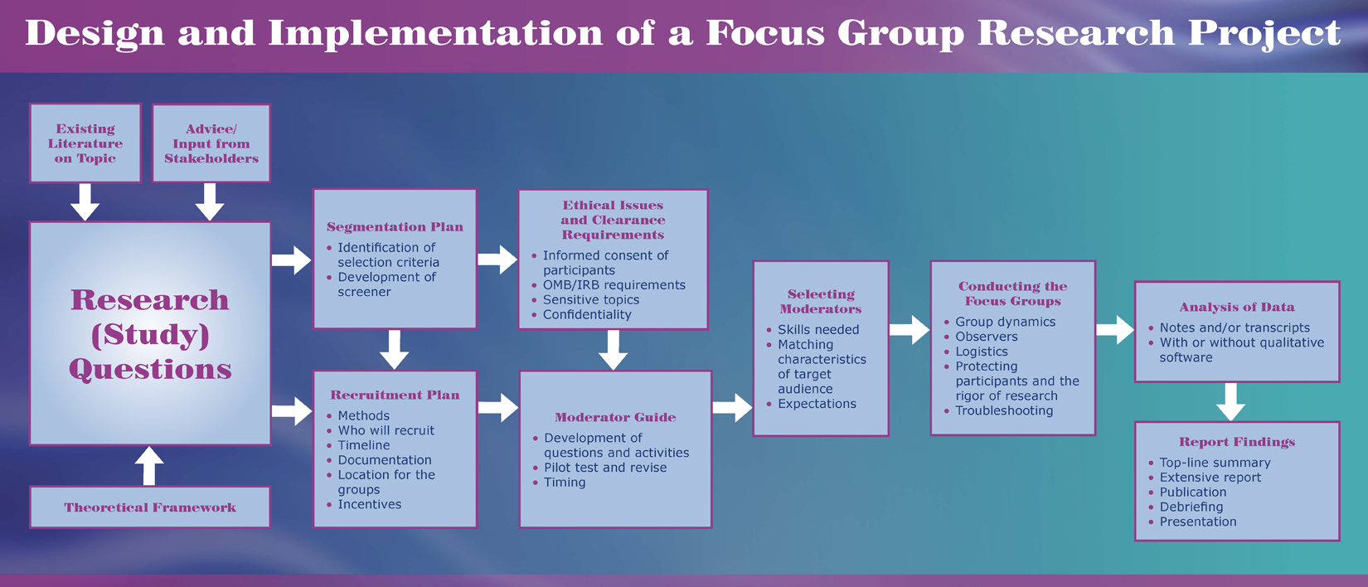
Focus Group Process

Slide 33
Justify Conclusions
Step 5

Slide 34
Data Analysis
The process of organizing, classifying, tabulating, and examining the information you collected and presenting the results so they can be easily understood by stakeholders.
Four key steps:
Develop a data analysis plan
Manage the data
Conduct data analysis
Report results

Slide 35
Considerations for a Data Analysis Plan
What type of data analysis will you need to perform for each indicator in the evaluation plan?
What statistical methods or content analysis do you plan to use?
What stratifications do you plan to examine among the data?
How will data be stored and managed?
What data aggregation systems or software will you need?
What types of tables, figures, and other information will you need to develop and report?

Slide 36
Examples of Quantitative Data Analysis
Descriptive statistics (frequencies, means, average)
Cross tabulations
Factor analysis
Regression analysis
Hierarchical linear modeling
Propensity scoring

Slide 37
Some Approaches to Qualitative Data Analysis
Discourse analysis focuses on patterns in speech and written word rather than the answers to a question
Content analysis counts the frequency and sequencing of particular words, phrases or concepts
Grounded theory is a line by line analysis of the data to identify themes, categories and theories.
Thematic analysis groups the data by themes

Slide 38
Analysis of Focus Group Data
Note taking is one of the first steps in analysis
Decide on the level of detail
Create a seating chart
For more detail, track what each respondent says
Record instances of strong agreement or disagreement
Distinguish between top of mind responses and those that result from probing
Record gestures and other forms of non-verbal communication
The group is the unit of analysis.
Reflect the range and diversity of experiences and perceptions of participants.
Identify outlier opinions.
Identify similarities and differences among groups of participants.

Slide 39
Analytical Considerations
Words
Context
Internal consistency
Frequency of comments
Extensiveness of comments
Intensity of comments
Specificity of responses
What was not said
Big ideas

Slide 40
Qualitative Data Analysis Software
Qualitative software is a tool to assist with the organization, retrieval, and analysis and display of focus group data.
Some commonly used packages include:
ATLAS.ti
QSR nVivo
AnSWR
CDC EZ-Text

Slide 41
Ensure Use and Share Lessons Learned
Step 6

Slide 42
Strategies for Sharing Results
Keep stakeholders apprised of the progress of the evaluation
Engage stakeholders in review of findings and development of recommendations
Tailor reports to your audiences
Executive summaries
Briefs
Include stories, illustrations and visually appealing graphics
Produce interim and final reports, as appropriate
Distribute report to stakeholders

Slide 43
References
Creswell JW, Klassen AC, Plano Clark VL, Smith KC for the Office of Behavioral and Social Sciences Research. Best practices for mixed methods research in the health sciences. August 2011. National Institutes of Health. Date retrieved. 2/14/12. http:/obssr.od.nih.gov/mixed_methods_research
Greenbaum, T.L. (1998). The Handbook for Focus Group Research. Thousand Oaks, CA: Sage Publications.
Krueger, R.A. (2000). Focus Groups: A Practical Guide for Applied Research, Third Edition. Thousand Oaks, CA: Sage Publications.

Slide 44
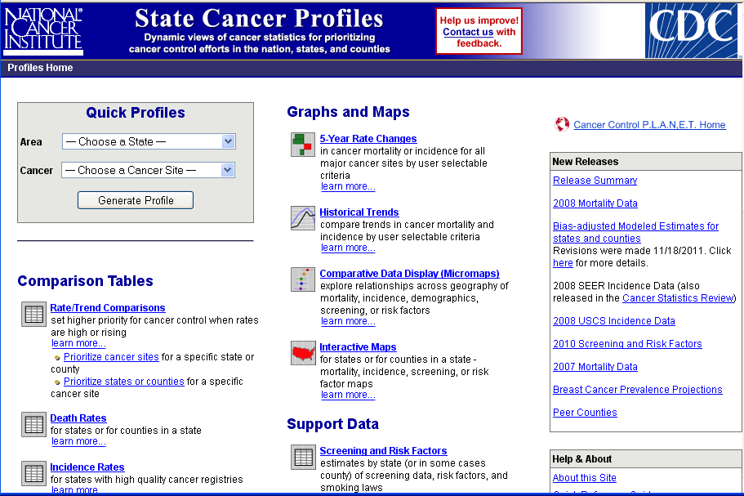
Cancer Data Sources
State Cancer Profiles (Cancer Control P.L.A.N.E.T.): http://statecancerprofiles.cancer.gov/
CDC – Cancer Data and Statistics: http://www.cdc.gov/cancer/dcpc/data/index.htm
Tools: http://www.cdc.gov/cancer/dcpc/data/tools.htm
Other Data Sources:
Complete Listing: http://www.cdc.gov/cancer/dcpc/data/other.htm
Electronic Health Records
BRFSS

